Slide 1
组 会 报 告
蓝 鑫
2019年11月14日

Slide 2
Encoder-decoder
Methods | Car | Bike | Person | Sky | Tree | Traffic Lights | Road | Sidewalk | Building | Fence | Sign | Pole | Bus | mAcc | mIoU
CE + Dice Loss | 83.4 | 47.3 | 74.1 | 90.4 | 91.2 | 46.0 | 98.1 | 46.3 | 77.5 | 69.4 | 31.4 | 45.0 | 75.9 | 67.8 | 55.3
1*Edge Loss | 80.4 | 55.9 | 66.7 | 94.3 | 91.2 | 45.2 | 97.5 | 40.6 | 80.1 | 64.8 | 34.3 | 44.8 | 78.2 | 67.2 | 53.8
5*Edge Loss | 81.5 | 44.7 | 75.6 | 94.8 | 90.4 | 38.2 | 97.9 | 45.6 | 81.9 | 70.2 | 41.3 | 39.9 | 76.2 | 67.5 | 54.1
10*Edge Loss | 80.2 | 54.2 | 75.0 | 94.6 | 90.6 | 41.8 | 97.8 | 48.6 | 79.1 | 72.8 | 30.9 | 45.4 | 74.6 | 68.1 | 53.9
20*Edge Loss | 82.2 | 44.6 | 72.1 | 93.8 | 91.0 | 41.6 | 97.9 | 45.4 | 82.5 | 72.7 | 35.4 | 44.6 | 77.6 | 67.8 | 54.3

Slide 3


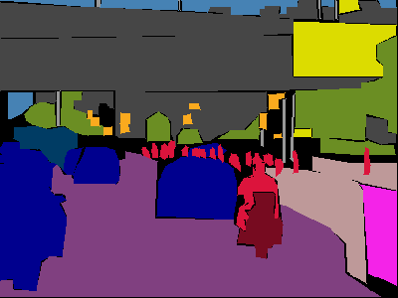



CE+Dice Loss
CE+Edge Loss*1
GT
CE+Edge Loss*5
CE+Edge Loss*10
CE+Edge Loss*20

Slide 4


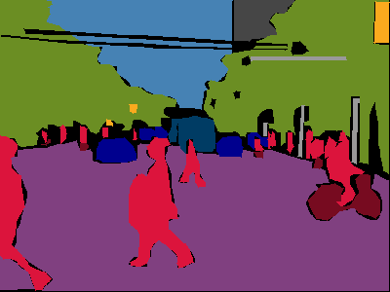



CE+Dice Loss
CE+Edge Loss*1
GT
CE+Edge Loss*5
CE+Edge Loss*10
CE+Edge Loss*20

Slide 5

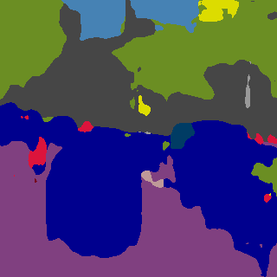
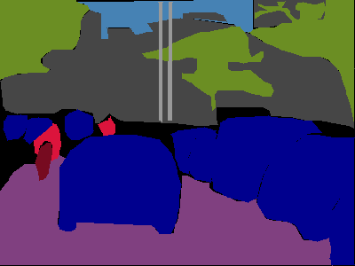



CE+Dice Loss
CE+Edge Loss*1
GT
CE+Edge Loss*5
CE+Edge Loss*10
CE+Edge Loss*20

Slide 6
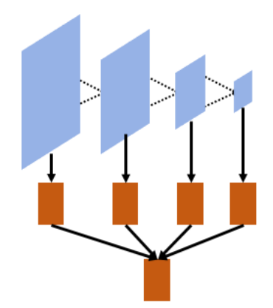
deeplab
Methods | Car | Bike | Person | Sky | Tree | Traffic Lights | Road | Sidewalk | Building | Fence | Sign | Pole | Bus | mIoU
CE + Dice Loss | 59.16 | 17.76 | 44.63 | 81.59 | 76.78 | 8.274 | 87.62 | 38.09 | 66.58 | 14.57 | 0.96 | 6.956 | 47.12 | 42.32
20*Edge Loss | 56.95 | 16.49 | 45.39 | 83.39 | 76.59 | 13.75 | 87.3 | 51.64 | 66.04 | 15.02 | 0 | 6.38 | 43.62 | 43.27
10*Edge Loss | 55.02 | 22.7 | 43.27 | 76.92 | 75.42 | 10.27 | 88 | 37.45 | 65.28 | 16.97 | 0.49 | 8.78 | 57.36 | 42.92
5*Edge Loss | 57.64 | 21.14 | 46.9 | 81.91 | 76.87 | 5.27 | 88.61 | 47.56 | 66.77 | 14.97 | 0.01 | 9.86 | 37.62 | 42.70
Edge loss + fuse loss | 55.37 | 19.16 | 44.86 | 82.84 | 76.86 | 11.41 | 87.35 | 44.79 | 67.67 | 16.3 | 0.05 | 7.4 | 58.1 | 44.01
Edge Loss + fuse loss
Edge Loss

Slide 7





ir
CE+Edge Loss*1
GT
CE+Edge Loss*5
CE+Edge Loss*10
CE+Edge Loss*20

Slide 8


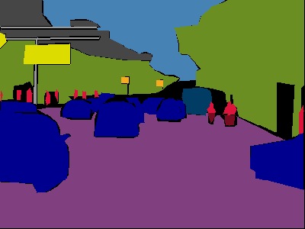



ir
CE+Edge Loss*1
GT
CE+Edge Loss*5
CE+Edge Loss*10
CE+Edge Loss*20

Slide 9
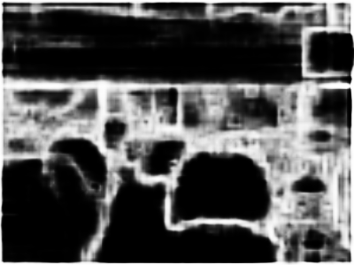
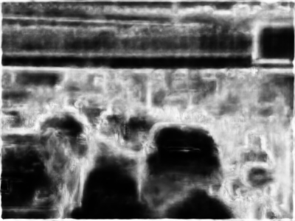

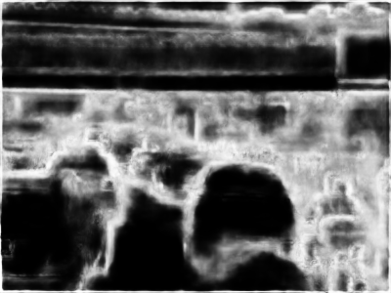
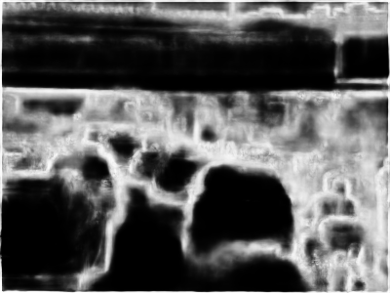
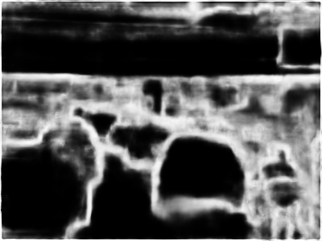
rgb
ir CE+Edge Loss*1
GT
ir CE+Edge Loss*5
ir CE+Edge Loss*10
ir CE+Edge Loss*20

Slide 10
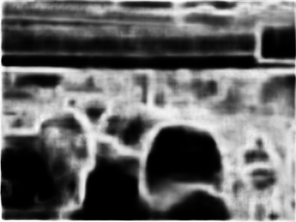
Edge loss + fuse loss
ir CE+Edge Loss*20
GT

Slide 11
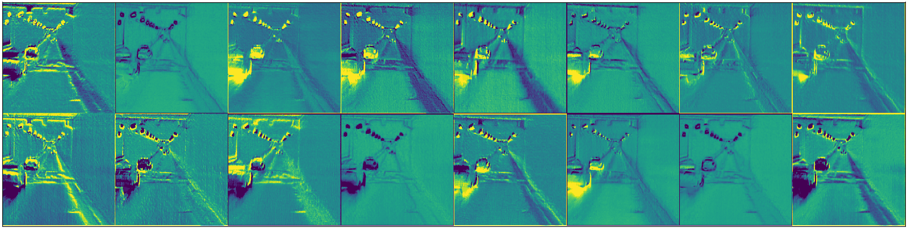
Stage 1

Slide 12
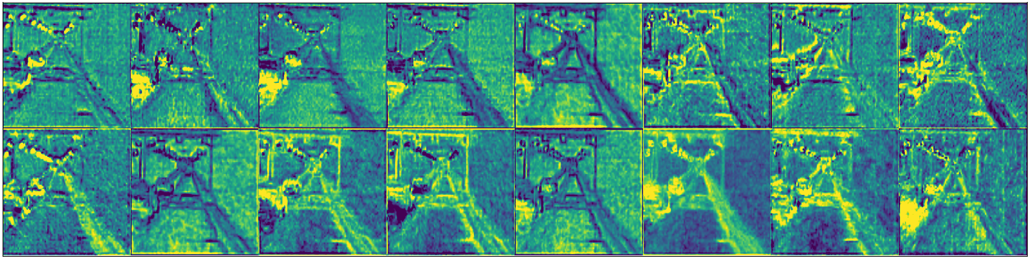
Stage 2

Slide 13
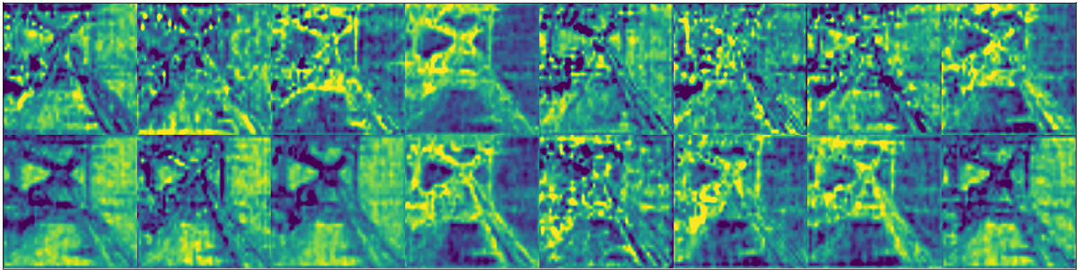
Stage 3

Slide 14
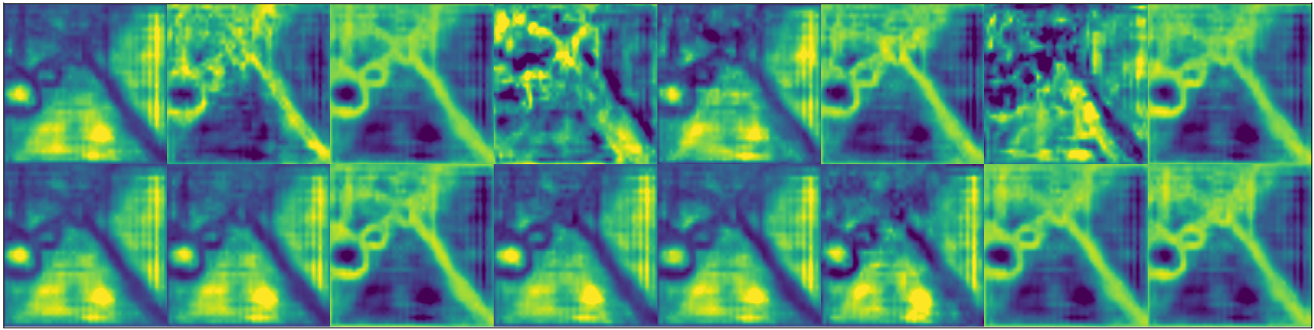
Stage 4

